Slide 1
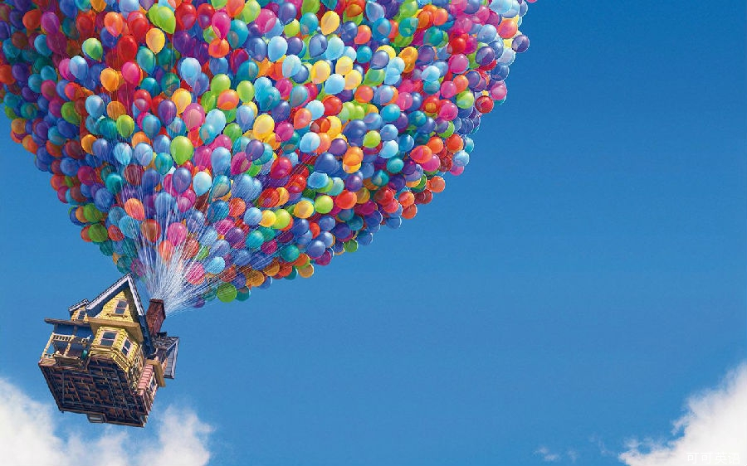
Web page
design for
the UP Film
Group3 Members:
Bu Jiaqi 22107671
Chonglin Zeng 22088607
Huang Yuting 22097233
Zhou Sitong 22114831

Slide 2
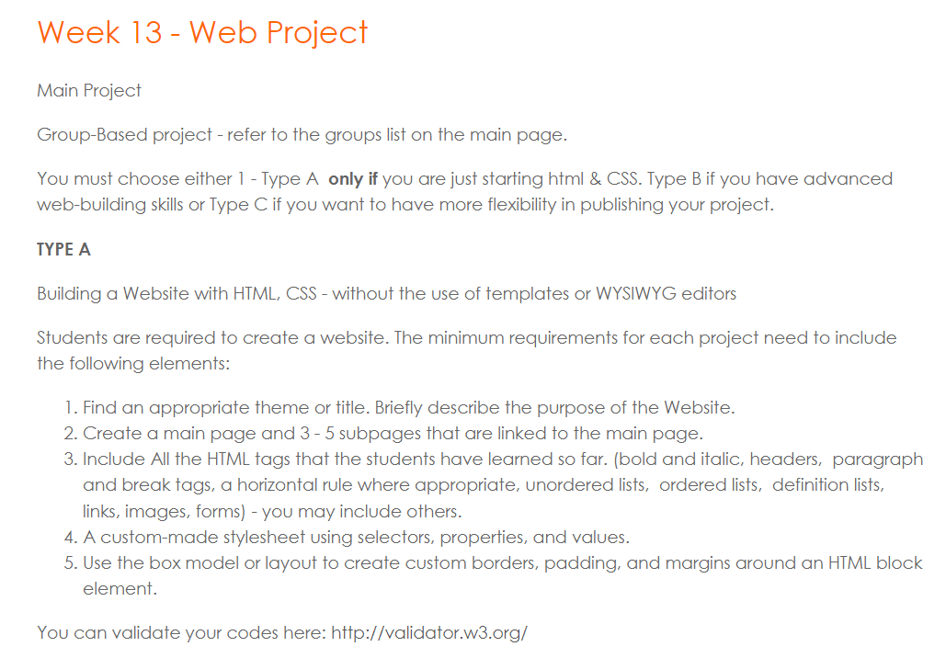
The style of the web project design
We Choose Type A
The reason why we choose Type A to design is that our group members are all the first time to learn HTML & CSS and how to design web pages.

Slide 3
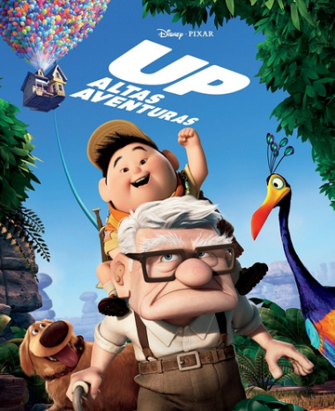
The purpose of the web project design
We Select to Introduce UP Film
We’d like to recommend this classical and wonderful film to everyone because there is no age boundaries on it, which means that it is suitable for people of all ages to watch, and there are dreams, love, life, adventures and journeys inside the movie.
If you’re interested in cartoon movie, awesome story, adventurous fairy tales, and exploring the meaning of love and life, feel free to enjoy our web pages and watch this film.
Target group: Anyone interested in this film

Slide 4
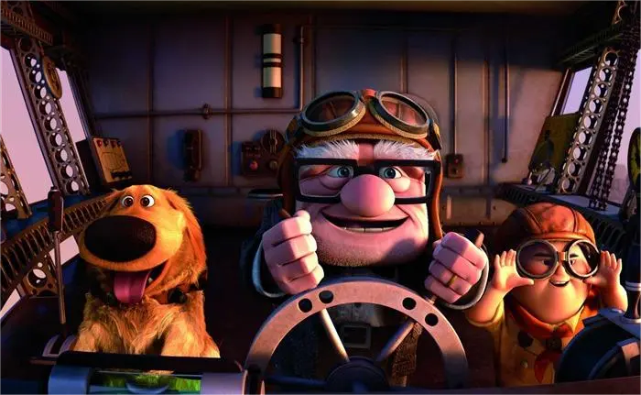
The ideas of the web project design
Firstly, we design Home Page with the film’s artwork style and contact information to attract people’s interests.
Secondly, we design About Page to introduce main plots and related information of this film.
Thirdly, we design Character Page to introduce the main roles with their information and videos.
Fourthly, we design Filmhub Page to promote this film with its trailer and music. Some nice film reviews are added to share the insights of the film.
Finally, we design Setting Page to show the picture gallery with some textual explanations.
We Design 5 Web Pages

